Slide 1


CSB4202 - DATABASE MANAGEMENT SYSTEMS
B.Tech – III Semester
Dr. A. Antonidoss
Associate professor
School of Computing Sciences,
Department of Computer Science and Engineering

Slide 2
Files of Records
A file is a sequence of records, where each record is a collection of data values (or data items).
A file descriptor (or file header) includes information that describes the file, such as the field names and their data types, and the addresses of the file blocks on disk.
Records are stored on disk blocks.
The blocking factor bfr for a file is the (average) number of file records stored in a disk block.
A file can have fixed-length records or variable-length records.

Slide 3
Files of Records (contd.)
File records can be unspanned or spanned
Unspanned: no record can span two blocks
Spanned: a record can be stored in more than one block
The physical disk blocks that are allocated to hold the records of a file can be contiguous, linked, or indexed.
In a file of fixed-length records, all records have the same format. Usually, unspanned blocking is used with such files.
Files of variable-length records require additional information to be stored in each record, such as separator characters and field types.
Usually spanned blocking is used with such files.

Slide 4
Operation on Files
Typical file operations include:
OPEN: Readies the file for access, and associates a pointer that will refer to a current file record at each point in time.
FIND: Searches for the first file record that satisfies a certain condition, and makes it the current file record.
FINDNEXT: Searches for the next file record (from the current record) that satisfies a certain condition, and makes it the current file record.
READ: Reads the current file record into a program variable.
INSERT: Inserts a new record into the file & makes it the current file record.
DELETE: Removes the current file record from the file, usually by marking the record to indicate that it is no longer valid.
MODIFY: Changes the values of some fields of the current file record.
CLOSE: Terminates access to the file.
REORGANIZE: Reorganizes the file records.
For example, the records marked deleted are physically removed from the file or a new organization of the file records is created.
READ_ORDERED: Read the file blocks in order of a specific field of the file.

Slide 5
Unordered Files
Also called a heap or a pile file.
New records are inserted at the end of the file.
A linear search through the file records is necessary to search for a record.
This requires reading and searching half the file blocks on the average, and is hence quite expensive.
Record insertion is quite efficient.
Reading the records in order of a particular field requires sorting the file records.

Slide 6
Ordered Files
Also called a sequential file.
File records are kept sorted by the values of an ordering field.
Insertion is expensive: records must be inserted in the correct order.
It is common to keep a separate unordered overflow (or transaction) file for new records to improve insertion efficiency; this is periodically merged with the main ordered file.
A binary search can be used to search for a record on its ordering field value.
This requires reading and searching log₂ of the file blocks on the average, an improvement over linear search.
Reading the records in order of the ordering field is quite efficient.

Slide 7
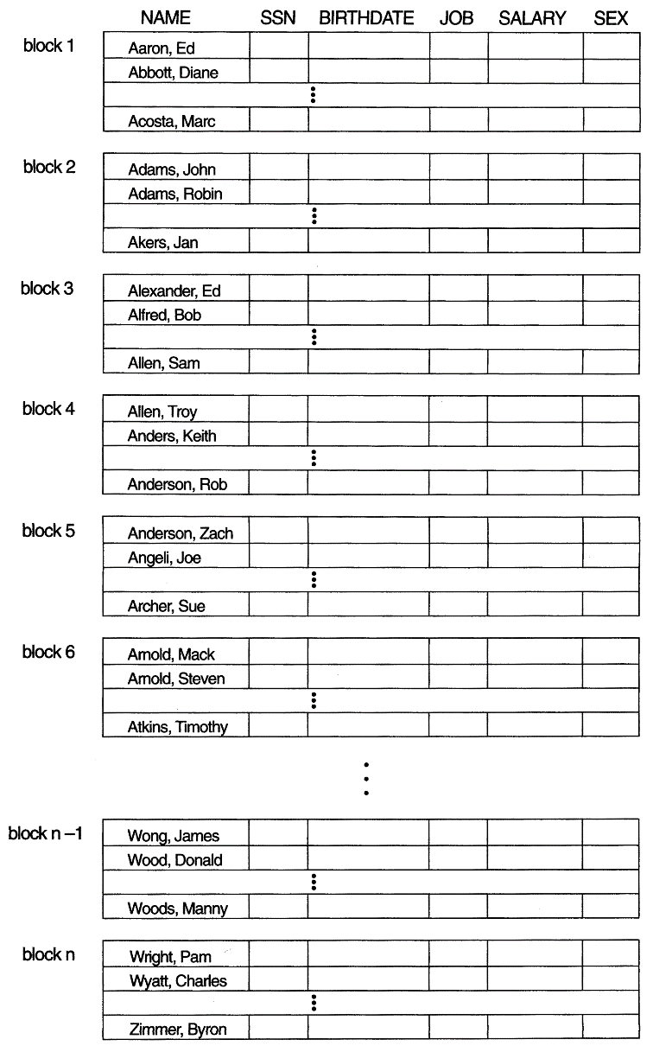
Ordered Files (contd.)

Slide 8
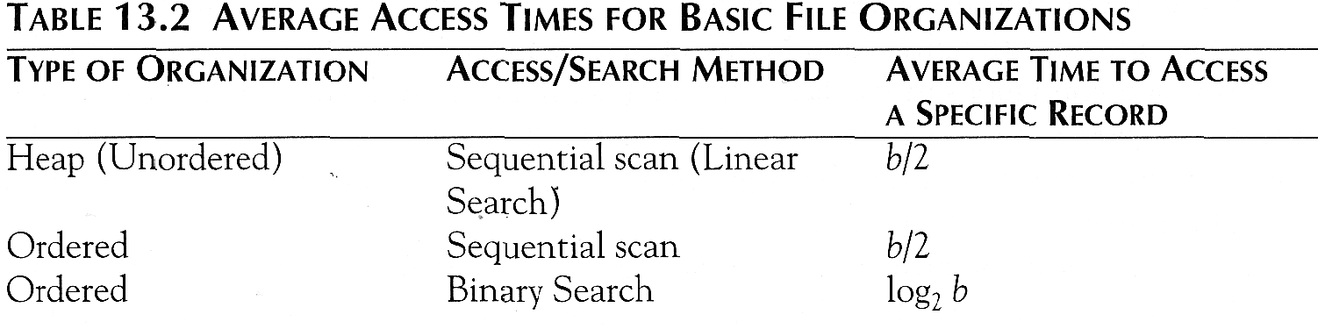
Average Access Times
The following table shows the average access time to access a specific record for a given type of file

Slide 9
Hashed Files
Hashing for disk files is called External Hashing
The file blocks are divided into M equal-sized buckets, numbered bucket₀, bucket₁, ..., bucket_{M-1}.
Typically, a bucket corresponds to one (or a fixed number of) disk block.
One of the file fields is designated to be the hash key of the file.
The record with hash key value K is stored in bucket i, where i=h(K), and h is the hashing function.
Search is very efficient on the hash key.
Collisions occur when a new record hashes to a bucket that is already full.
An overflow file is kept for storing such records.
Overflow records that hash to each bucket can be linked together.

Slide 10
Hashed Files (contd.)
There are numerous methods for collision resolution, including the following:
Open addressing: Proceeding from the occupied position specified by the hash address, the program checks the subsequent positions in order until an unused (empty) position is found.
Chaining: For this method, various overflow locations are kept, usually by extending the array with a number of overflow positions. In addition, a pointer field is added to each record location. A collision is resolved by placing the new record in an unused overflow location and setting the pointer of the occupied hash address location to the address of that overflow location.
Multiple hashing: The program applies a second hash function if the first results in a collision. If another collision results, the program uses open addressing or applies a third hash function and then uses open addressing if necessary.

Slide 11
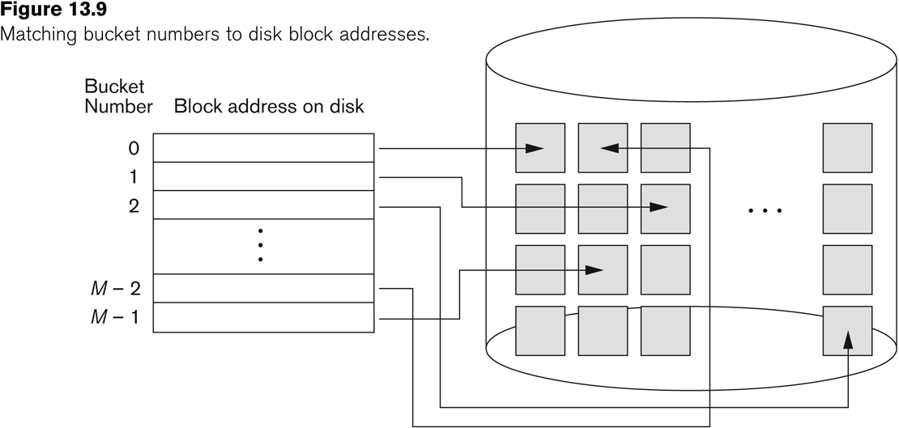
Hashed Files (contd.)

Slide 12
Hashed Files (contd.)
To reduce overflow records, a hash file is typically kept 70-80% full.
The hash function h should distribute the records uniformly among the buckets
Otherwise, search time will be increased because many overflow records will exist.
Main disadvantages of static external hashing:
Fixed number of buckets M is a problem if the number of records in the file grows or shrinks.
Ordered access on the hash key is quite inefficient (requires sorting the records).

Slide 13
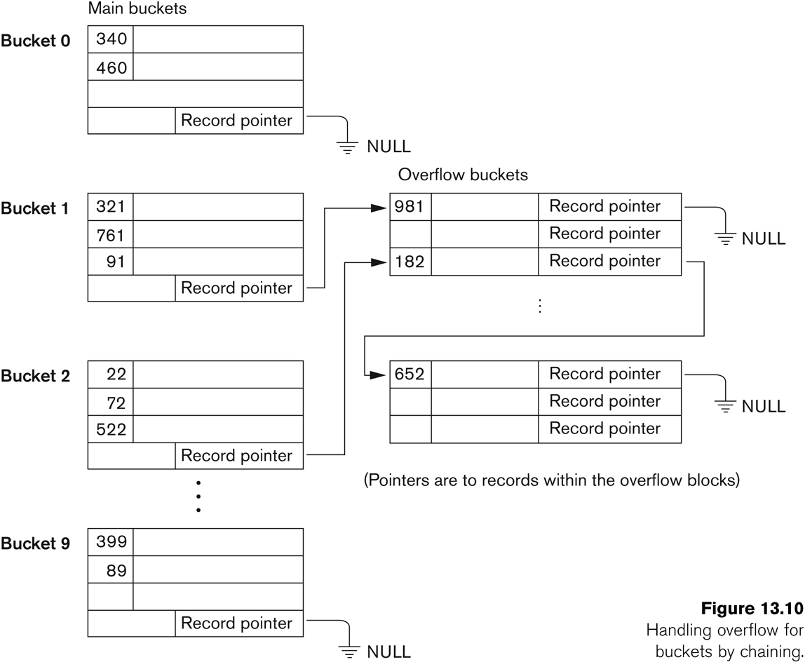
Hashed Files - Overflow handling

Slide 14
Dynamic And Extendible Hashed Files
Dynamic and Extendible Hashing Techniques
Hashing techniques are adapted to allow the dynamic growth and shrinking of the number of file records.
These techniques include the following: dynamic hashing, extendible hashing, and linear hashing.
Both dynamic and extendible hashing use the binary representation of the hash value h(K) in order to access a directory.
In dynamic hashing the directory is a binary tree.
In extendible hashing the directory is an array of size 2^{d} where d is called the global depth.

Slide 15
Dynamic And Extendible Hashing (contd.)
The directories can be stored on disk, and they expand or shrink dynamically.
Directory entries point to the disk blocks that contain the stored records.
An insertion in a disk block that is full causes the block to split into two blocks and the records are redistributed among the two blocks.
The directory is updated appropriately.
Dynamic and extendible hashing do not require an overflow area.
Linear hashing does require an overflow area but does not use a directory.
Blocks are split in linear order as the file expands.

Slide 16
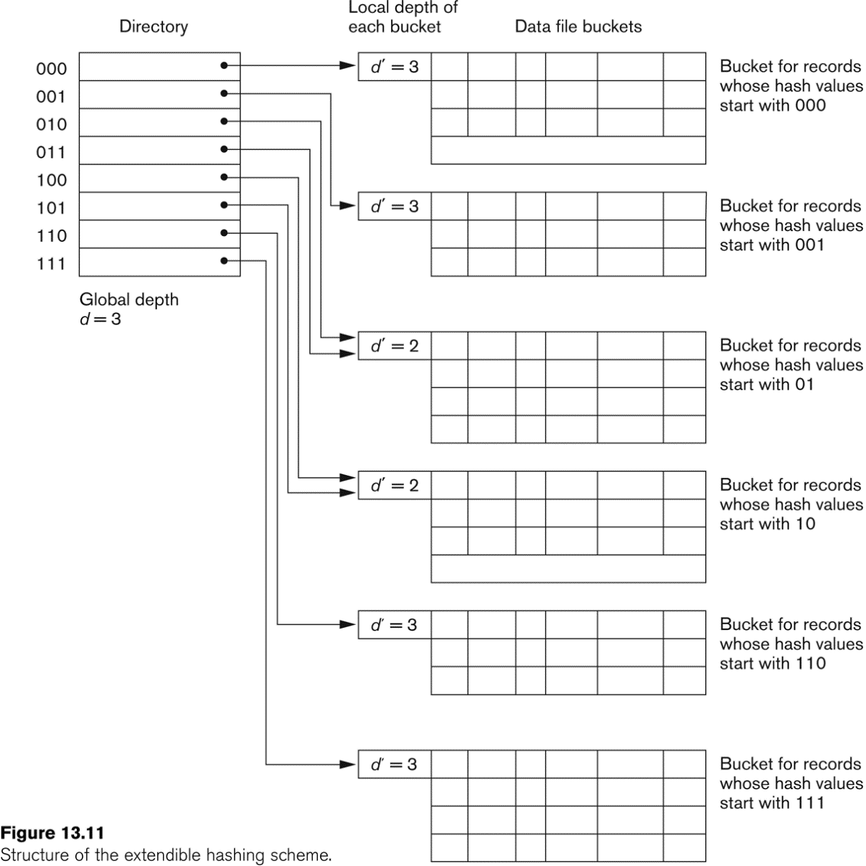
Extendible Hashing

Slide 17
Purpose of Database Systems (or) Advantages of DBMS (or) Disadvantages of File System
In the early days, database applications were built directly on top of file systems
Drawbacks of using file systems to store data:
Data redundancy and inconsistency:
In file system , information is stored as files, so redundancy (duplication/repetition of data) occurs.
Has multiple file formats, duplication of information in different files.
Ex. If a customer has changed his address, then the updation must be done in both files, otherwise this leads to inconsistency.
Difficulty in accessing data:
Need to write a new (application) program to carry out each new task
Data isolation: - Multiple files and formats. Data is scattered among many files and each is isolated from the other.
4. Integrity problems: (checking the correctness of data)
The stored data must satisfy certain constraints.
Integrity constraints (e.g. account balance > 0) become “buried” in program code rather than being stated explicitly
Hard to add new constraints or change existing ones

Slide 18
Atomicity of updates:
Atomic means “It must happen in it’s entirely or not at all “.
Failures may leave database in an inconsistent state with partial updates carried out.
Example: Transfer of funds from one account to another should either complete or not happen at all.
This inconsistency is efficiently overcome by DBMS.
Concurrent access Anomalies:
Concurrent accessed needed for performance
Uncontrolled concurrent accesses can lead to inconsistencies
Example: Two people reading a balance and updating it at the same time.
Anomalies are the problems that arise due to a flaw in Database.
Security problems:
Hard to provide user access to some, but not all, data.
Enforcing security in file system is difficult since application programs are written as and when needed.
Thus, Database systems offer solutions to all the above problems.

Slide 19
Summary
Disk Storage Devices
Files of Records
Operations on Files
Unordered Files
Ordered Files
Hashed Files
Dynamic and Extendible Hashing Techniques

Slide 20
Quiz
The method in which records are physically stored in a specified order according to a key field in each record is
a) hash. b) direct.
c) sequential.
d) all of the above

Slide 21
Quiz
The method in which records are physically stored in a specified order according to a key field in each record is
a) hash. b) direct.
c) sequential.
d) all of the above
Answer a

Slide 22


Slide 23
The End

